Slide 1
iTable
格日乐
2024/1/16

Slide 2
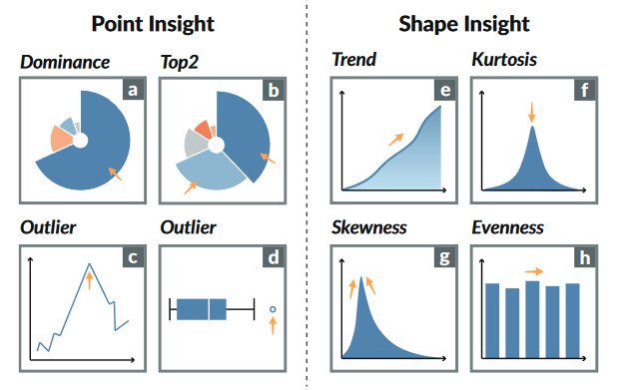
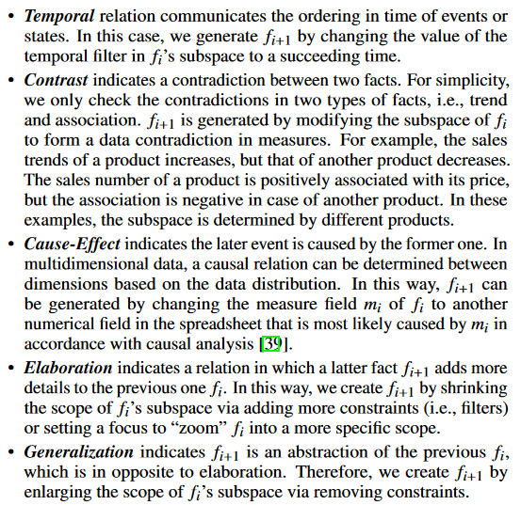
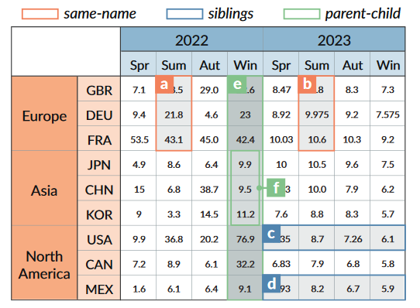
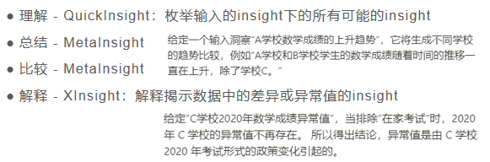
Preliminary knowledge
Insight：Data insight refers to the valuable information and understanding that can be derived from analyzing and interpreting the data.
Insight Correlation：
Application-specific Correlations
Correlation based on header structure
Correlation based on semantic infomation
Notes:
Correlation

Slide 3
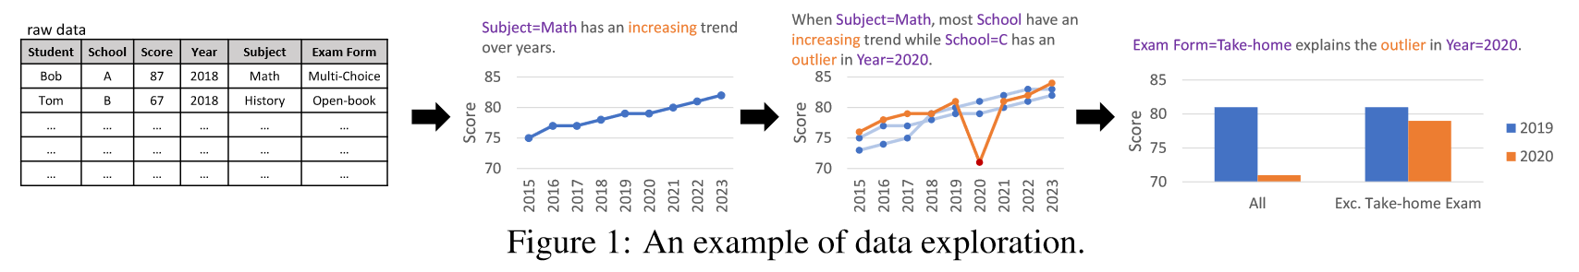
Preliminary knowledge
Story Telling/Data Exploration：The process of finding insights consisting of an iterative and interactive series of data analysis operation. (such as filtering, sorting, and grouping)
Notes:
Story Telling/Data Exploration

Slide 4
Problem Statement
Need: Efficient and Rapid Exploration of Tabular Data for the Average User
Insight finding-Existing Work
Traditional analysis and exploration of tabular data require experts with statistical knowledge to perform extensive mathematical operations to discover interesting patterns.
人工方法耗时耗力
需要精通领域知识的数据科学专家
Automatical insight tools：Tools like QuickInsights are adept at automatically discovering profound and intriguing patterns from multi-dimensional data.
生成的insights间关联不大，包含信息不丰富
过程可解释性差（黑盒）
无法充分理解用户意图
LLM-based method：mostly
推理过程可解释性仍然很差
更偏向于MLP method，缺乏用户参与度，即人机交互部分

Slide 5
Challenges
Optimization of Generated Results: The goal is not merely to mine and recommend insights but to create a series of semantically connected insights that form a cohesive 'data-story'.
Maybe we can further transcend the limitations of simple linear relationships.
Interpretability Issue: Incorporating LLMs systems to build semantic relationships between insights in natural language. This could enhance user comprehension of why certain insights are interconnected.
Accurate Understanding of User Requirements: Users might not initially know exactly what information they seek from a dataset. Their requirements often become clearer as they explore and gather more information. The system needs to effectively capture these evolving requirements to accurately guide the user's exploration process.

Slide 6
Methodology: an LLM-Based, Semi-Automated Data Exploration System
Key Ideas
Integration of ReAct & ReActTable Concepts
Combine the 'Chain of Thoughts Prompt' and 'External Actions' methodologies derived from the ReAct & ReActTable frameworks. (In order to make LLM more efficient and accurate)
Insight Template: Insight -> Description Translation
Insights within a table can be described using natural language focusing on [location, semantics], enabling the LLM to accurately comprehend the data's context.
During the insight calculation process, a 'template function' is used to compute the corresponding descriptions of these insights.
Incorporating User-Generated Natural Language Queries
Users are allowed to *insert natural language queries* **during** the exploration process, influencing the direction of future system recommendations.
2. Iterative Process
For a selected insight I, the system inputs I.description along with the context into the LLM.
The LLM then recommends potential next steps for exploring insights, including their locations and semantic relationships.
The user selects the next insight to explore and repeats the process.
During this iteration, users can insert their questions in natural language, which are added to the context for the LLM, further refining the exploration direction.

Slide 7
Methodology: an LLM-Based, Semi-Automated Data Exploration System
Key Ideas
Integration of ReAct & ReActTable Concepts
Combine the 'Chain of Thoughts Prompt' and 'External Actions' methodologies derived from the ReAct & ReActTable frameworks. (In order to make LLM more efficient and accurate)
Insight Template: Insight -> Description Translation
Insights within a table can be described using natural language focusing on [location, semantics], enabling the LLM to accurately comprehend the data's context.
During the insight calculation process, a 'template function' is used to compute the corresponding descriptions of these insights.
Incorporating User-Generated Natural Language Queries
Users are allowed to *insert natural language queries* **during** the exploration process, influencing the direction of future system recommendations.
2. Iterative Process
For a selected insight I, the system inputs I.description along with the context into the LLM.
The LLM then recommends potential next steps for exploring insights, including their locations and semantic relationships.
The user selects the next insight to explore and repeats the process.
During this iteration, users can insert their questions in natural language, which are added to the context for the LLM, further refining the exploration direction.

Slide 8
Insight Description Template
格日乐 冯云姗
2024/1/31

Slide 9
Methodology: an LLM-Based, Semi-Automated Data Exploration System
Application Scope：fuzzy and high-level tasks，用户意图不明确，或者分析目标通常很复杂，需要多个步骤才能完全解决。eg.“分析过去一年的销售业绩”
3 Components：
用户界面：用户以自然语言发出查询，显示计算结果和探索过程，支持人机交互
Insight Engine：
执行分析操作、生成洞察：根据给定的data scope计算insight
以自然语言呈现结果：以基于规则的方式进行insight-to-NL转换
LLM：
用户意图分析，基于上下文（用户问题、数据集领域知识和当前探索状态）
insight 选择，驱动下一步探索过程

Slide 10
Methodology: an LLM-Based, Semi-Automated Data Exploration System
Application Scope：fuzzy and high-level tasks，用户意图不明确，或者分析目标通常很复杂，需要多个步骤才能完全解决。eg.“分析过去一年的销售业绩”
3 Components：
用户界面：用户以自然语言发出查询，显示计算结果和探索过程，支持人机交互
Insight Engine：
执行分析操作、生成洞察：根据给定的data scope计算insight
以自然语言呈现结果：以基于规则的方式进行insight-to-NL转换
LLM：
用户意图分析，基于上下文（用户问题、数据集领域知识和当前探索状态）
insight 选择，驱动下一步探索过程

Slide 11
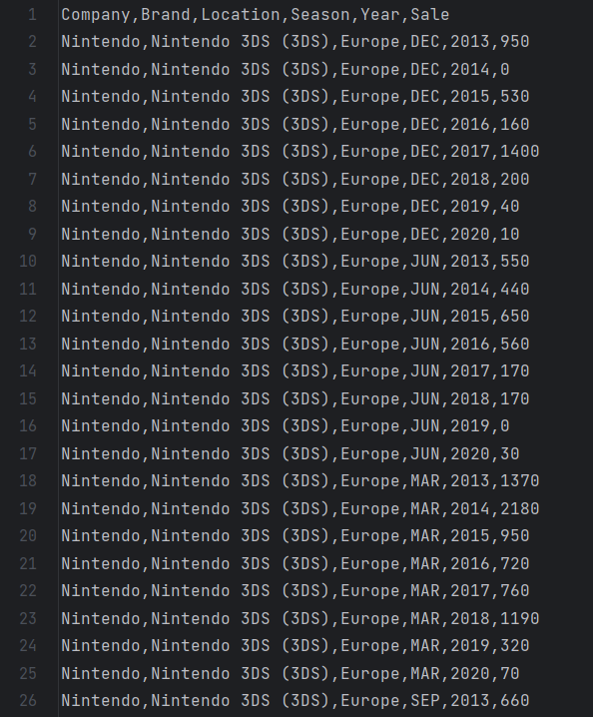
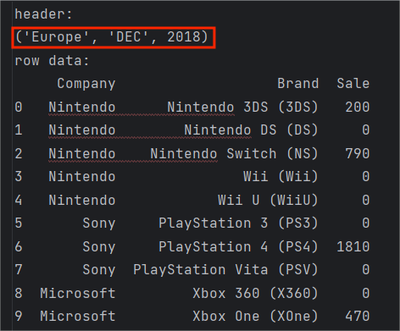
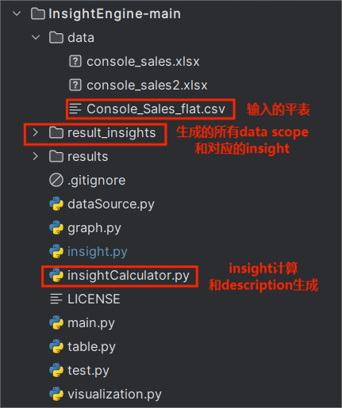
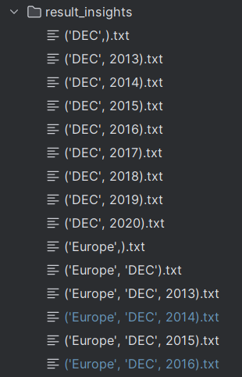
目录结构说明
生成的insight list
文件名是某些列的定值，即data scope的筛选标准
Console_Sales_flat.csv
目录结构

Slide 12
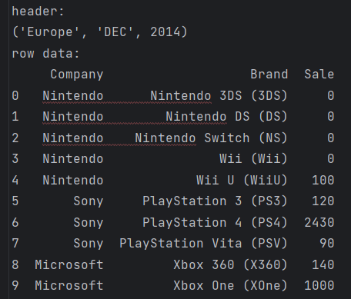
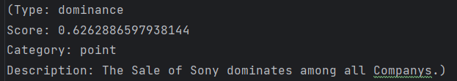
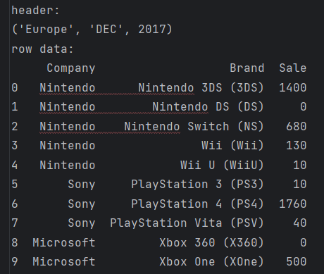
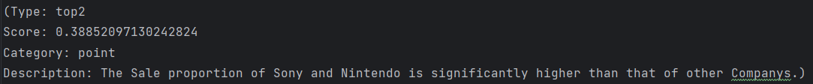
Insight Description - Point Insight
1. Dominance
2. Top2

Slide 13
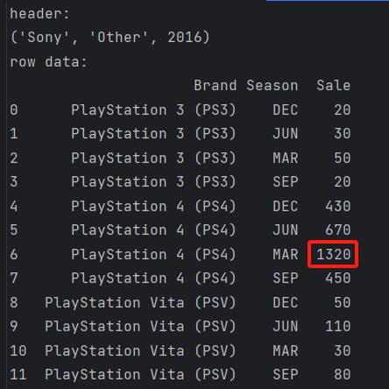
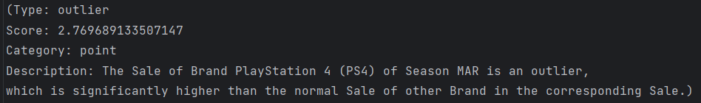
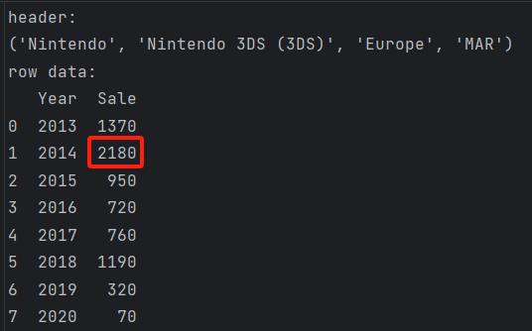
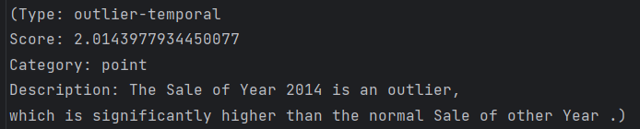
Insight Description - Point Insight
3. Outlier
4. Outlier-temporal

Slide 14
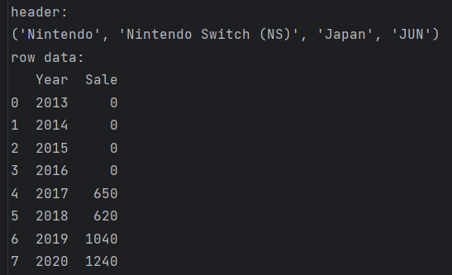
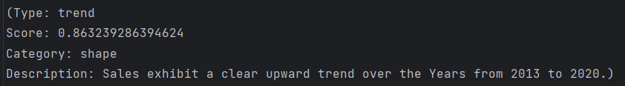
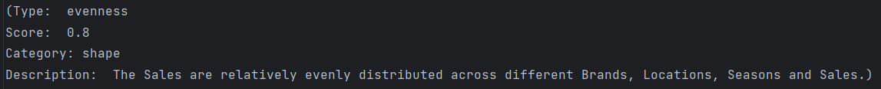
Insight Description - Shape Insight
1. Trend
2. Evenness

Slide 15
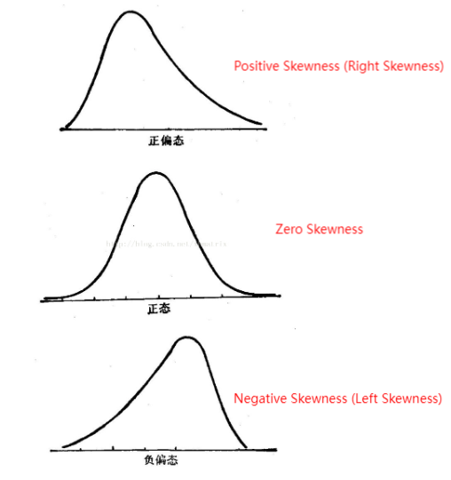
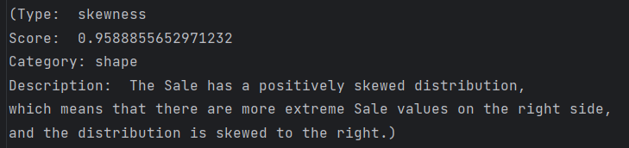
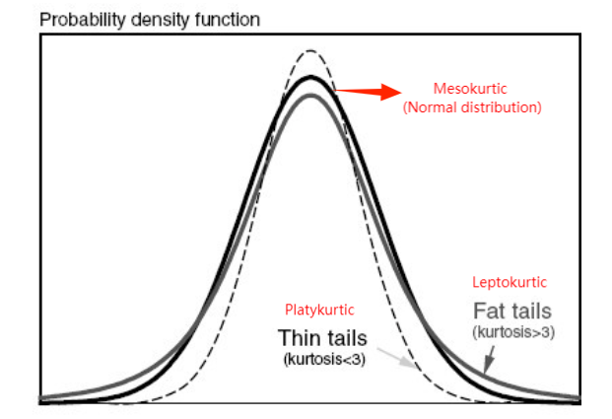
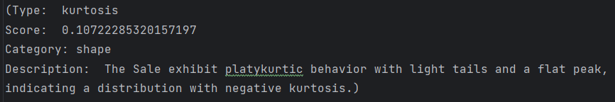
Insight Description - Shape Insight
3. Skewness
4. Kurtosis

Slide 16
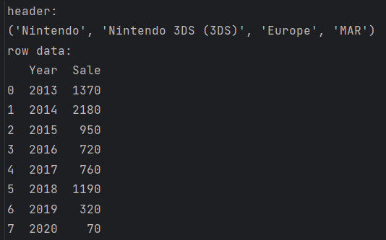
下一步工作计划
修改未能良好表述的description
语法细节
数据集表头描述
data scope中的表头不能完整表述信息

Slide 17
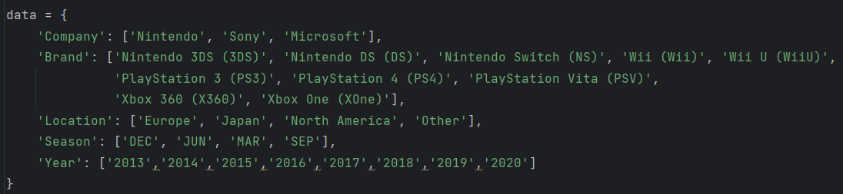
下一步工作计划
完成Insight Visualization（生成对应的Vegalite）
对于每一个data scope，最后输入到LLM的信息应该包括三部分
完整平表的结构（√）
data scope context
insight description（√）

Slide 18
工作安排
云姗：compound计算、vegalite生成
格日乐：
继续改template
debug aggregate部分的内容（√）
修改description细节
改表头（√）
写header template
代码传github
写说明文档

Slide 19
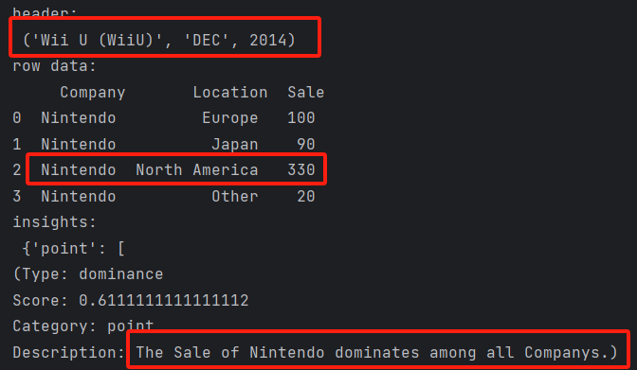
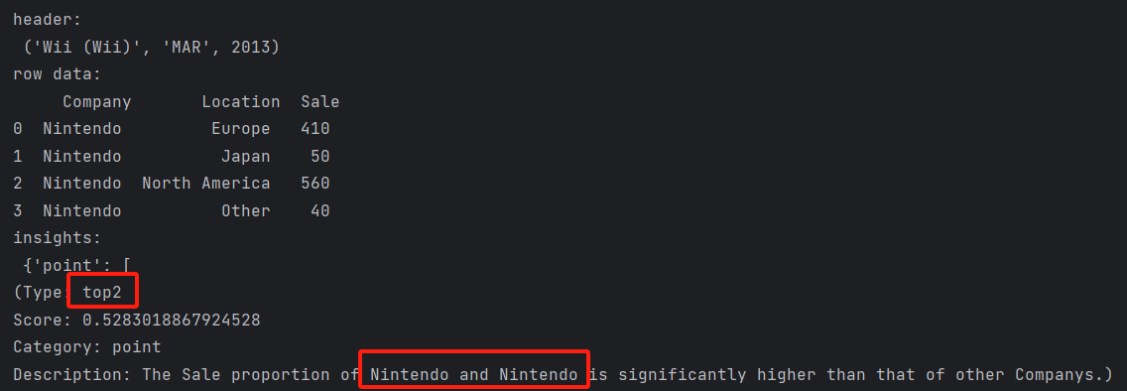
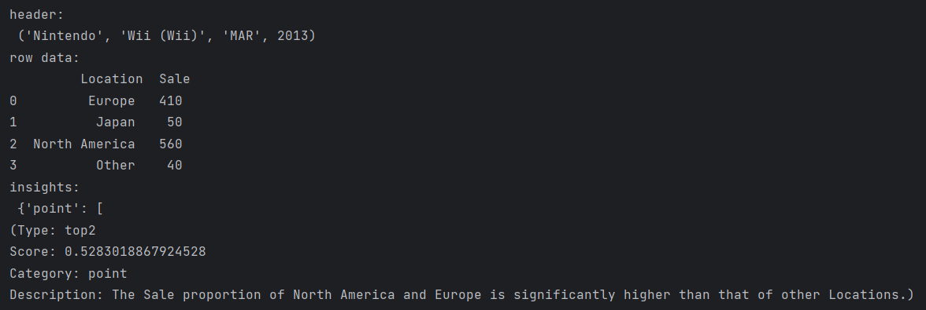
Description细节问题
Dominance同理
Top2不能直接取前两行的第一列单元格内容
×
√

Slide 20
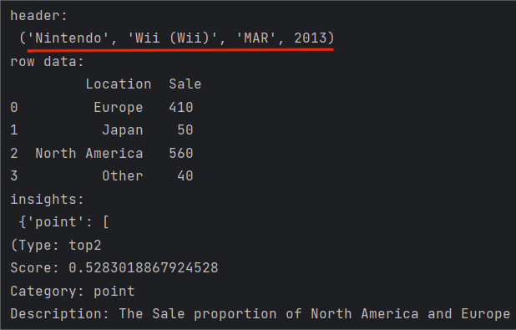
Description细节问题
Top2不能直接取前两行的第一列单元格内容
-> 需要增加一步聚合
想法：聚合到主列的实体不止一个时
本质上是将多余的全包含的列提取到header里，所以insight的数量不会变

Slide 21
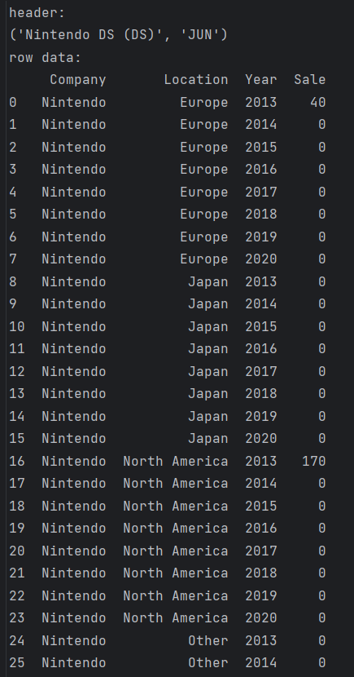
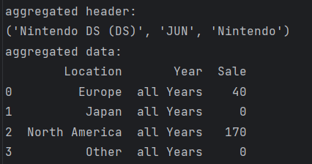
修改聚合方式
前端显示上：在interface中可以显示raw data和真正含有insight的aggregated data

Slide 22
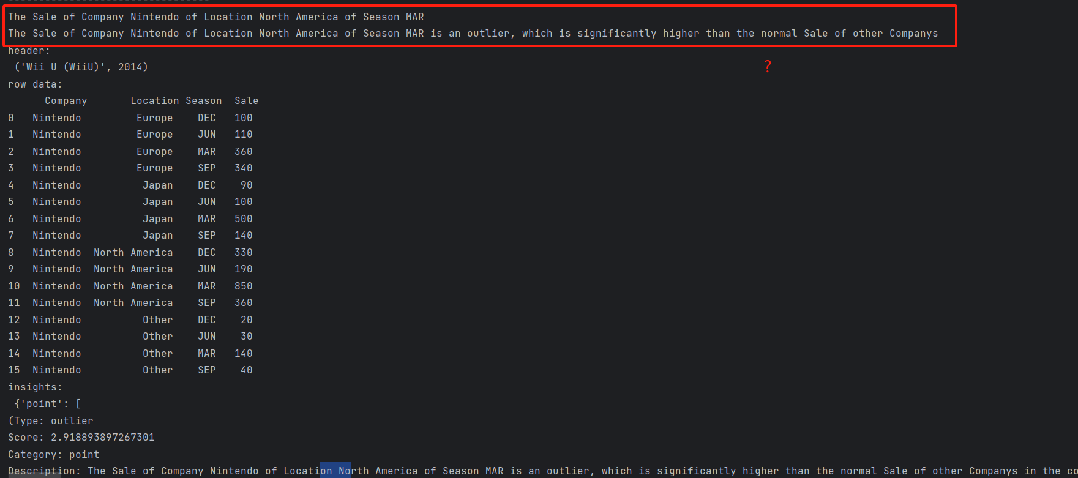
Description细节问题
Outlier
前面的输出（√）
in the corresponding xx,xx, and xx.

Slide 23
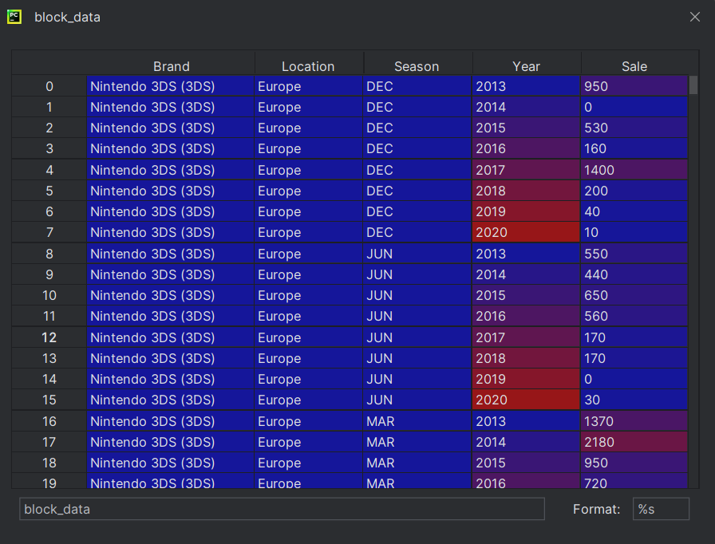
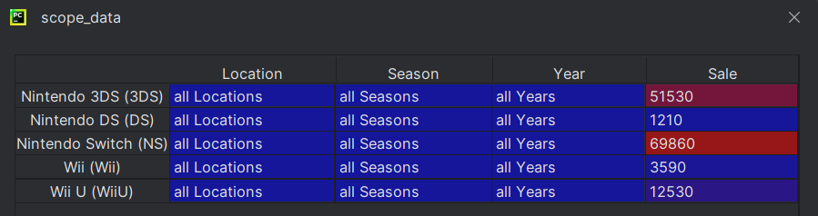
Description细节问题
并不是all
TODO：cell内容去重
聚合后的df

Slide 24
问题
aggregate时，怎么枚举才能全覆盖？

Slide 25
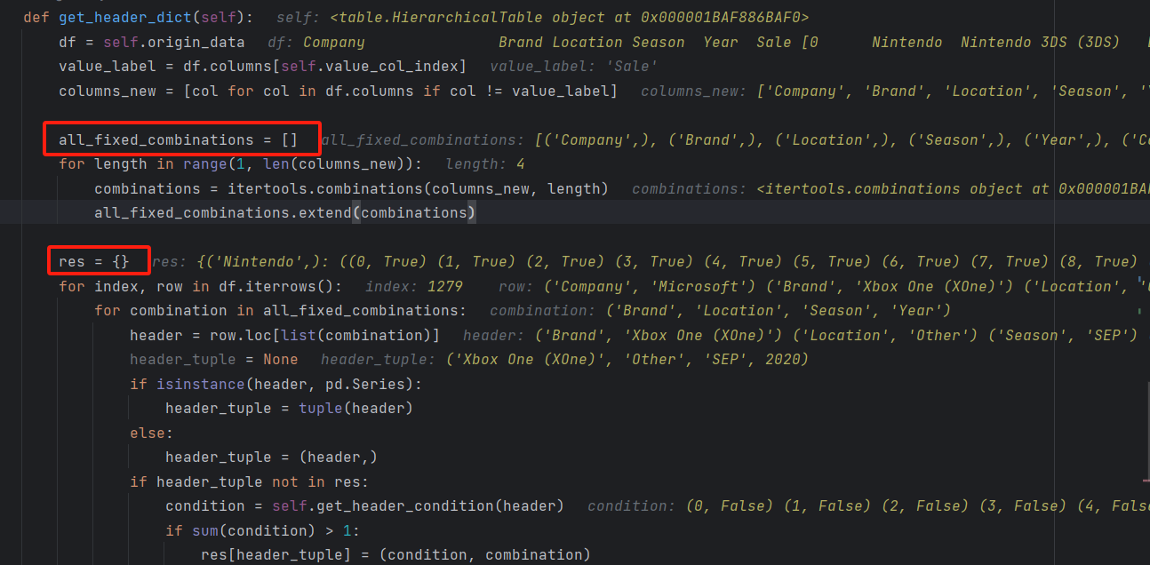
Description细节问题
要问云姗的事：
res这个是干嘛的 all_fixed_combinations不是已经把所有header的情况枚举出来了嘛

Slide 26
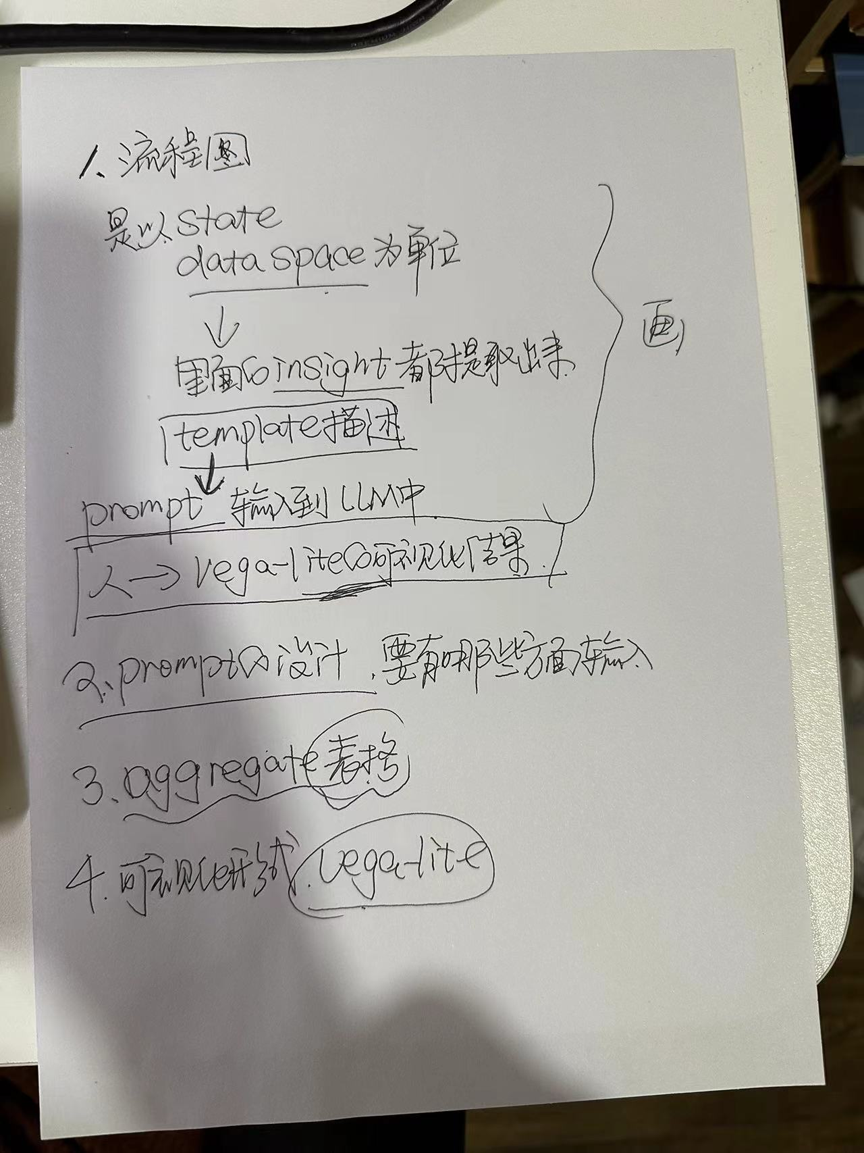
2.18会议
紧急：【生成一个可以测试的结果】
header加到template里（√）
加入structure（√）
写prompt（√）
处理aggregate的问题，融合后的header要变（√）
问题：
要想分析compound必不可少，因为需要对比
few shot的编写
LLM给出的下一步探索方向是否不只是subspace
用户界面设计

Slide 27
prompt1
You are a professional tabular data analyst and help me with my data exploration. Data exploration is a key step in data analysis. It is necessary to filter the data table back and forth to extract sub-regions of the data, and calculate important pattern information in the data in the sub-regions, which is called insight.
There are eight types of insights, divided into two categories. They are dominance, top2, outlier, and outlier-temporal belonging to point insight, and trend, kurtosis, skewness, and evenness belonging to shape insight.
I will give you two pieces of information: the first is a question I want to explore in this data table, and the second is the current status of exploration (for each data subregion, I will describe the complete data table structure, the Filter conditions for the data sub-area, insight type and description obtained in the data sub-area.) I will tell you the above information in the following format:
" Question: {} Current data subspace: [ Table structure: {} Filter condition: {} Context: {} In the filtered subspace, the insight is: {Type: {} Category: {} Description:{}} ] "
Based on my question and the current exploration status, you need to give me three next exploration directions that you think may be helpful in finding the answer to the question, that is, the data sub-area that should be explored next, using the same tuple form as Filter condition. Reply me.
Do you understand your task? Below I'll give you the problem and current status.

Slide 28
test1
Question: I want to know the sales of each company in 2016.
Table structure: {
'Company': ['Nintendo', 'Sony', 'Microsoft'],
'Brand': ['Nintendo 3DS (3DS)', 'Nintendo DS (DS)', 'Nintendo Switch (NS)', 'Wii (Wii)', 'Wii U (WiiU)', 'PlayStation 3 (PS3)', 'PlayStation 4 (PS4)', 'PlayStation Vita (PSV)', 'Xbox 360 (X360)', 'Xbox One (XOne)'],
'Location': ['Europe', 'Japan', 'North America', 'Other'],
'Season': ['DEC', 'JUN', 'MAR', 'SEP'],
'Year': ['2013', '2014', '2015', '2016', '2017', '2018', '2019', '2020']}
Context: Filtered the original data table with the conditions: [Season = DEC]
In the filtered subspace, the insight is:
Type: dominance
Category: point insight
Description: The Sale of Sony dominates among all Companys.)
}
+ last paragraph

Slide 29
test

Slide 30
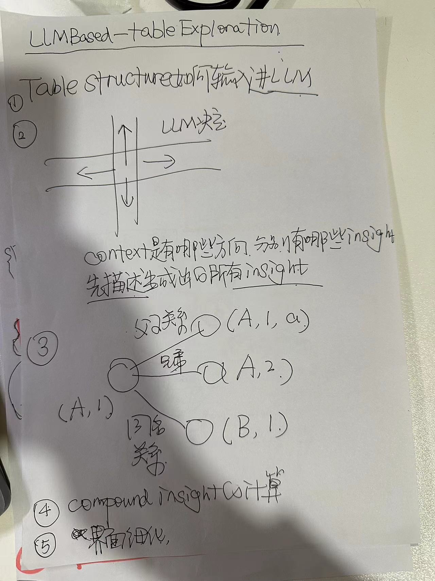
2.23会议
改context：根据当前状态先枚举下一跳中含有的insight，然后从合法的状态中直接选择
table structure不合理

